Slide 1


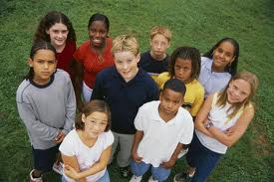
Vaccinations help protect from infectious diseases
Vaccination toolkit for schools developed by Public Health England in Collaboration with Wiltshire Council

Slide 2
Learning Objectives
By the end of this presentation you should be able to describe:
What a vaccine is made of
Know what the symptoms are measles are
Know what is the best way of protecting yourself from measles
Help to reassure your friends if they are concerned about a vaccination and let them know where they can find more information.

Slide 3
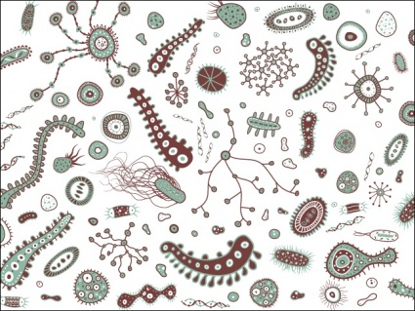
How vaccines protect
  Vaccines have been developed to protect people and animals against a wide range of diseases.
  These are safe forms of the
  disease causing microbe.
  Vaccines fool your body into thinking they have seen the germ so when you come into contact with the real thing they protect you
Notes:
Vaccines fool your body into thinking they have seen the pathogen so when you come into contact with the real thing they give you a protective immune response

Slide 4
Getting vaccinated not only protects yourself, but other people too.
  Some people can not have vaccines because they are already poorly.
  If everyone who is able to have a vaccine does have it, then not only do they help protect themselves but they protect these other people too.
Notes:
If people do not have a weak immune system or have an allergy to an ingredient of the vaccine they may not be able to have a vaccine

Slide 5
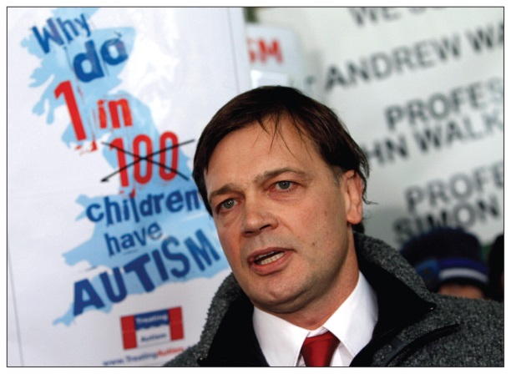
Parents were worried about vaccines
In 1998 a scientist said that the Measles, Mumps and Rubella (MMR) vaccine could give children Autism
THIS WAS WRONG
All studies found no link between the MMR vaccine and autism.
The vaccine is safe
Notes:
http://www.bmj.com/content/342/bmj.c7452
As the ensuing vaccine scare took off, critics quickly pointed out that the paper was a small case series with no controls, linked three common conditions, and relied on parental recall and beliefs.4 Over the following decade, epidemiological studies consistently found no evidence of a link between the MMR vaccine and autism.5 6 7 8 By the time the paper was finally retracted 12 years later,9 after forensic dissection at the General Medical Council’s (GMC) longest ever fitness to practise hearing,10 few people could deny that it was fatally flawed both scientifically and ethically. But it has taken the diligent scepticism of one man, standing outside medicine and science, to show that the paper was in fact an elaborate fraud.

Slide 6
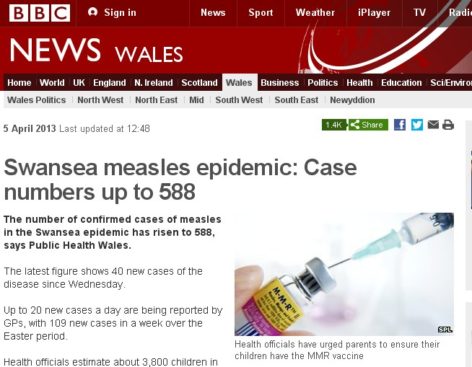
Current status
Vaccination rates fell below the 95%
level recommended by the World Health
Organization to ensure herd immunity
In 2008, for the first time in 14 years,
measles was declared endemic in
England and Wales.
Hundreds of thousands of children in the UK are currently unprotected as a result of the scare
Notes:
Although vaccination rates in the United Kingdom have recovered slightly from their 80% low in 2003-4,19 they are still below the 95% level recommended by the World Health Organization to ensure herd immunity. In 2008, for the first time in 14 years, measles was declared endemic in England and Wales.20 Hundreds of thousands of children in the UK are currently unprotected as a result of the scare, and the battle to restore parents’ trust in the vaccine is ongoing
For measles the WHO definition of an endemic is the same strain of measles virus circulating for more than 1 year.
UK is still endemic for measles (October 2013) - in September 2013 there was a cluster of measles cases in Bristol resulting from an unvaccinated person coming back from holiday from Thailand – other hotspots are visitors returning from Africa or India.
With an infection of 14 days then a chain of 26 people getting infected on after another makes measles endemic in a country.
In October 2013 there is currently an outbreak in Germany – with lots of UK visitors going for Octoberfest – if any of those haven’t been vaccinated they will probably get infected and bring it back to the UK.

Slide 7
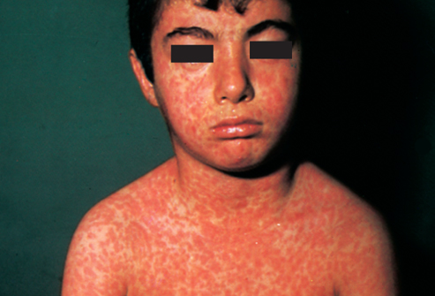
Early Symptoms of Measles
Feel like you have a cold
Red eyes and sensitivity to light
Fever (up to 40.6 °C)
Greyish white spots in the mouth and throat
Tiredness, irritability and general lack of energy
Red-brown spotty rash 2 to 4 days after first symptoms

Slide 8
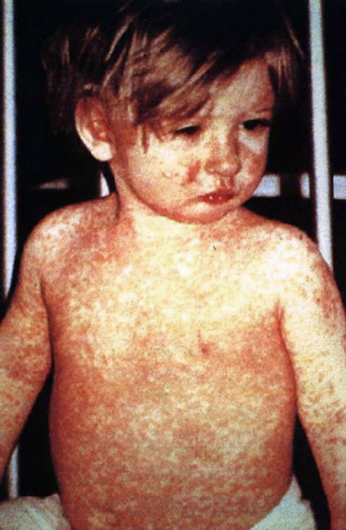
Consequences of Measles
People who get the most severe measles infections are children under 1, teenagers and adults.
Measles infection is nasty .... 5 days in bed, 2 weeks off school
Complications include - ear infections
- breathing difficulties
- diarrhoea
- swelling of your brain
Notes:
Pneumonia infection of the lungs
Encephalitis is an infection/swelling of the brain
In the UK it would normally be less than 1 in 5,000 due to the medical care we have, but worldwide 18 people die per hour of measles.

Slide 9
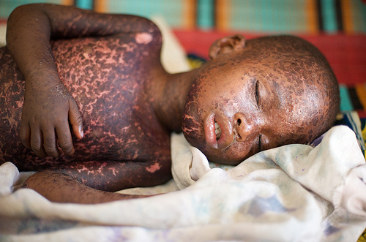
One in 30 people in the latest outbreak were admitted to hospital
In third world countries 1 in 5,000 people who get measles die.
Worldwide 18 people die from Measles each HOUR
Notes:
1:5000 worldwide die, in west it is not so high due to availability of medical care

Slide 10
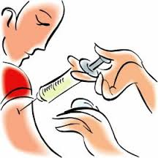
Vaccines for Measles
Bad news: There is no treatment for measles, Doctors can only treat some of the symptoms
Good news: Can be prevented by a simple vaccine MMR
MMR protects against :
Mumps, Measles and Rubella

Slide 11
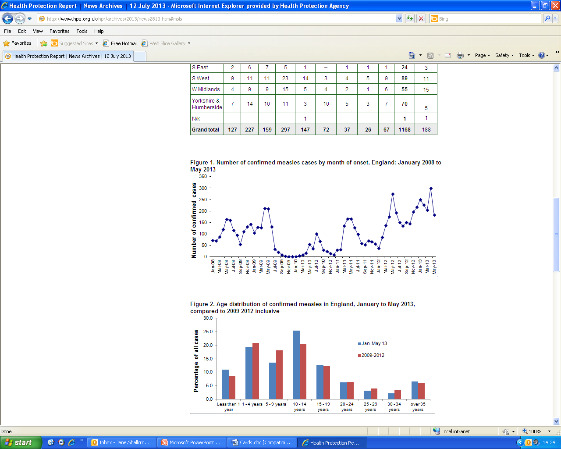
What ages were most people who got measles?
Notes:
http://www.hpa.org.uk/hpr/archives/2013/news2813.htm#msls
Children under 19 years are most likely to get measles

Slide 12
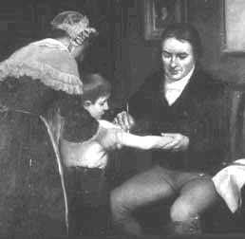
Edward Jenner - Smallpox
If everyone who is able to be vaccinated did take the vaccine then some diseases could be wiped out all together.
This was done with smallpox and could be done with measles.
Notes:
Jenner invented the first vaccine. Named after the vaccinia virus Vacca (cow) cowpox

Slide 13
Decrease of meningitis
Notes:
When the Meningitis C vaccine was introduce the incidence decreased quickly (blue columns).
New vaccine for Meningitis B is now bring developed.

Slide 14
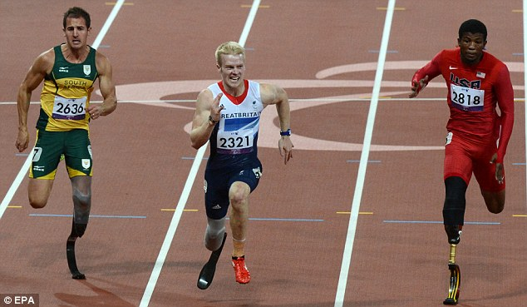
Jonnie Peacock 2012 - Paralympics
‘On fire! The Briton raced to glory last night in the men's final - a huge achievement for the athlete who almost died of meningitis when he was a youngster. Peacock was only five when he contracted meningitis in October 1998. He was taken to Addenbrooke’s Hospital in Cambridge, where he lay in a coma for four days with doctors warning his parents that he may not survive.’
Notes:
If the vaccines had been available when Jonnie Peacock was a baby he may have been protected against Meningitis

Slide 15
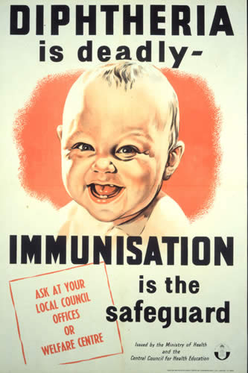
Vaccines are free
There are lots of diseases you can be protected from by vaccination:
For example:
Diphtheria, whooping cough, measles, mumps, rubella, meningitis, human papillomavirus.
Sometimes you take other vaccines when you visit countries that have diseases that we don’t have in England such as Yellow Fever, Cholera.
If you haven’t been vaccinated against measles you
can talk to your parents. The Doctor can check your
records and vaccinate you if you need it.
Notes:
Poster from the 1941 Diphtheria campaign

Slide 16
Why do you think people don’t get vaccinated?

Slide 17
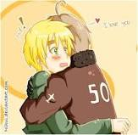
Worries about Vaccinations
Are they safe?
Will it hurt?
Will it make me feel unwell?
Will it really protect me?

Slide 18
New Vaccines are being developed
Are they safe?
Yes, before vaccines are given to children they are thoroughly tested on tens of thousands of adult volunteers to ensure the safety of the vaccine before children are be given it. This is the strictest testing for any medicine.
It will hurt?
Most people say it is like a little scratch. Hurts a lot less than having your ears pierced
Will it make me feel unwell?
Sometimes people have a little sore patch at the vaccination site, or may have a temperature a few days afterwards.
Will it really protect me?
Vaccines are really good at stimulating your body to make a protective response, but we are all different and a very few people may not produce a protective response.
Discuss any concerns you have with your GP and you can also look www.nhs.uk/vaccinations for more information
Notes:
The more people who get vaccinated the greater the herd immunity and the more that other people who do not respond to the vaccine, or who can not have the vaccine are protected. Also the microbes can mutate so it is important to keep your vaccinations up to date.

Slide 19
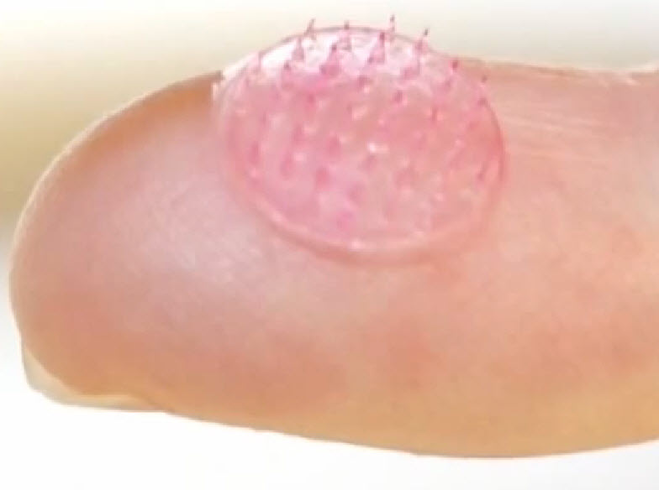
Vaccines of the Future
A new Meningitis B vaccine has recently been licensed in Europe so if people have this vaccine it will help protect them from this disease.
New vaccines are being developed for flu which don’t need to be injected – it is a spray in your nose.
In the future we hope that vaccines will be developed that won’t need injections and that can all be given at the same time.

Slide 20
We recommend you have the vaccinations your Doctor recommends, to keep you safe from diseases like Measles

